Slide 1

Project Title : Implementing Deep Learning Models for Face Recognition Domain: Pattern Recognition and Neural Networks
Second Review
Course Code: CS7510
Course Title: Project 2
Register Number:23MSP3068
Name: Dharshani A
Date: 01/03/2024

Slide 2
Abstract
Facial recognition technology holds immense promise for revolutionizing access control systems, offering a secure, keyless, and personalized approach to authentication. However, the widespread adoption of facial recognition systems in real-world applications like biometric building access has been hindered by challenges such as accuracy, speed, and susceptibility to spoofing attacks. In this project, we propose a comprehensive framework for developing a robust facial recognition system tailored for biometric access control. Leveraging convolutional neural networks (CNNs) and advanced techniques like Siamese networks, we aim to enhance accuracy, speed, and security in facial recognition. Our approach involves data collection, preprocessing, model training, and evaluation, with a focus on real-world applicability and scalability. By addressing these challenges, we seek to contribute to the advancement of access control systems, offering a secure and efficient solution for modern security needs.
Keywords: Facial recognition, Access control systems, Biometrics, Convolutional neural networks, Siamese networks, Security, Authentication.

Slide 3
Introduction
In the realm of access control systems, the quest for secure, efficient, and user-friendly solutions continues to drive innovation.
Traditional methods, such as keycards and PIN codes, while prevalent, are not without their limitations, often susceptible to theft, loss, or unauthorized duplication.
Biometric alternatives, particularly facial recognition technology, offer a promising avenue for overcoming these challenges.
However, the widespread adoption of facial recognition systems has been hindered by their limited performance in diverse environmental conditions and susceptibility to spoofing attacks.
To address these issues, this project seeks to develop a robust facial recognition system tailored for biometric building access.
By leveraging convolutional neural networks (CNNs) and exploring advanced techniques like Siamese networks, we aim to enhance accuracy, speed, and security in facial recognition.
Our approach involves comprehensive data collection, preprocessing, model training, and evaluation, with a focus on real-world applicability and scalability.
Through this endeavor, we anticipate making significant contributions to the field of access control systems, offering an innovative solution that addresses key challenges and paves the way for enhanced security and convenience in various domains.

Slide 4
Need of study
1. Ensure accurate recognition across varied conditions (e.g., lighting, appearance changes) for reliable access control.
2. Develop rapid and efficient recognition methods to minimize entry delays and enhance user experience.
3. Implement robust security measures to counter spoofing attempts, safeguarding against unauthorized access.
4. Address privacy concerns by prioritizing data protection and ensuring user consent in facial recognition systems.
5. Facilitate seamless integration with existing access control infrastructure for easy adoption and scalability.

Slide 5
Problem Statement
Modern urban settings require secure, efficient, and non-intrusive access control systems.
Traditional access methods like keys, cards, and PINs can be lost, stolen, or forgotten, compromising security and convenience.
Facial recognition offers a promising keyless and personalized alternative for access control.
Achieving consistent accuracy and reliability in varied conditions (lighting, angles, facial changes) is a significant challenge.
The project aims to develop a facial recognition system for building access, focusing on enhanced accuracy, speed, and robustness against environmental variations and spoofing attempts.

Slide 6
Objectives
To explore techniques for improved facial feature differentiation.
To develop a CNN model for accurate recognition of BTS members.
To implement preprocessing and augmentation for enhanced performance.
To evaluate model accuracy and reliability on test datasets.
To prepare for Siamese network integration to learn fine-grained facial features.
To ensure scalability and compatibility with existing security infrastructure.

Slide 7
Related Work
Research explores Siamese neural networks for face recognition and kinship verification.
Transfer learning, ResNet, and VGGNet architectures are key techniques utilized.
These studies highlight the networks' versatility in biometric verification and security enhancement.
The collective progress indicates a unified approach towards addressing complex biometric and deep learning challenges.
Each piece of research contributes to advancing identification methods and relationship analysis, facilitating security and social analytical applications.

Slide 8
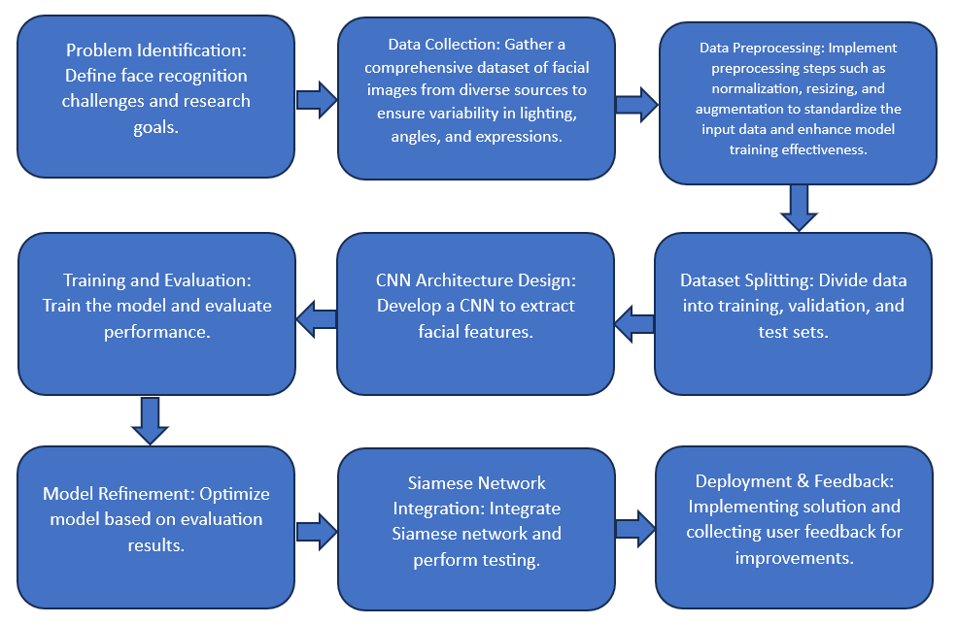
Proposed Methodology

Slide 9
Proposed Methodology
Problem Identification:
Identify challenges in facial recognition, including lighting, angle, and expression variations. Define research goals to address these challenges.
Data Collection:
Collect a diverse dataset of facial images from various sources to ensure variability in lighting, angles, and expressions. Ensure the dataset represents real-world scenarios.
Data Preprocessing:
Implement preprocessing steps like normalization, resizing, and augmentation to standardize input data. These steps enhance model training effectiveness and robustness to variations.
Dataset Splitting:
Divide collected data into training, validation, and test sets. This ensures proper evaluation and prevents overfitting during model training.
CNN Architecture Design:
Design a Convolutional Neural Network (CNN) tailored for facial feature extraction. Experiment with different architectures to optimize performance.

Slide 10
Proposed Methodology
Training and Evaluation:
Train the CNN model using the training data and evaluate its performance on the validation set. Adjust hyperparameters and model architecture as needed for better results.
Model Refinement:
Optimize the CNN model based on evaluation results. Fine-tune parameters and layers to improve accuracy and generalization.
Siamese Network Integration:
Integrate a Siamese network architecture to capture fine-grained differences between facial features. Test the integrated model and compare performance with the CNN.
Deployment & Feedback:
Deploy the facial recognition solution in real-world scenarios, such as biometric access control systems. Gather user feedback for further improvements and iterations.

Slide 11

Dataset
Source of the Dataset: @bts.bighitofficial on Instagram
No. of Observations: 50 images * 7 members
Total Observations after Augmentation: 16800 = 50*7*24*2

Slide 12
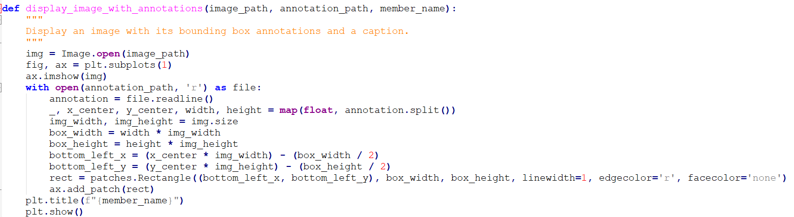
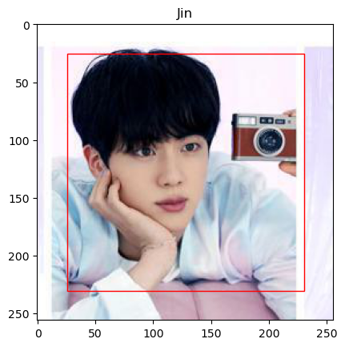
Exploratory Data Analysis

Slide 13
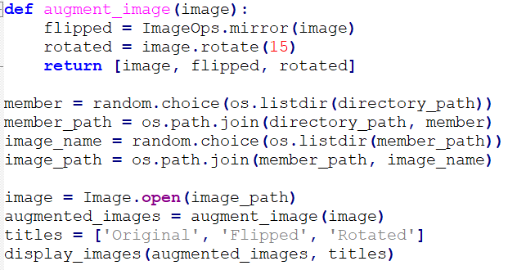
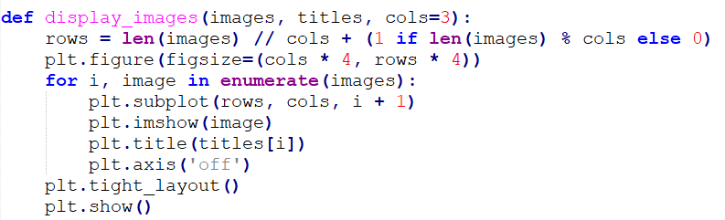
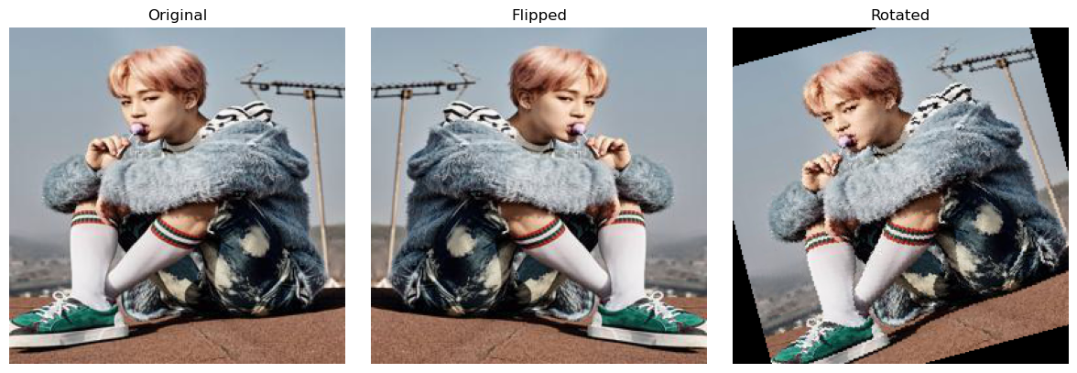
Exploratory Data Analysis

Slide 14
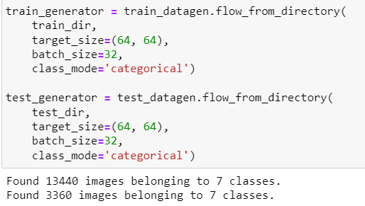
Exploratory Data Analysis
Train-Test Split for 16800 images
Test size = 0.2 = 20%
Train Data = 40*7*24*2
Test Data = 10*7*24*2

Slide 15
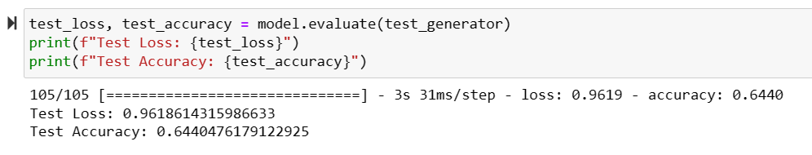
Results and Discussion
Initial Convolutional Neural Network model after train-test-split
The CNN model defined here starts with a simpler configuration, utilizing layers like `Conv2D` for convolutional operations and `MaxPooling2D` for down-sampling.
The network architecture progresses from 16 filters in the first convolutional layer to 32 filters in the second, indicating a relatively modest complexity.
It includes a `Flatten` layer to convert the 2D feature maps into a 1D vector, followed by a `Dense` layer with 64 neurons for classification purposes and another `Dense` layer for output with Softmax activation.
This model is straightforward, aiming for a balance between feature learning and computational efficiency.

Slide 16
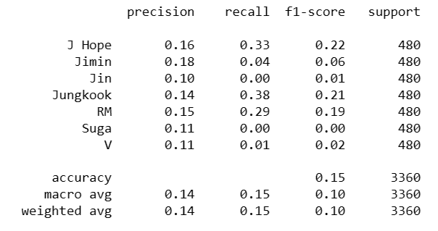
Results and Discussion
CNN with Regularization
This CNN architecture is more complex, starting with 32 filters and scaling up to 128 filters in subsequent convolutional layers, suggesting a deeper network designed to capture more intricate features.
It introduces additional techniques like `Dropout` for regularization to prevent overfitting and `l1_l2` regularization within the `Dense` layer, enhancing the model's generalization capability.
This model also uses a `Flatten` layer and a highly dense layer with 512 neurons, indicating a focus on learning high-level features for more accurate classification.
The inclusion of advanced regularization techniques and a more substantial number of filters per layer points towards an emphasis on performance and accuracy, possibly at the expense of increased computational load.

Slide 17

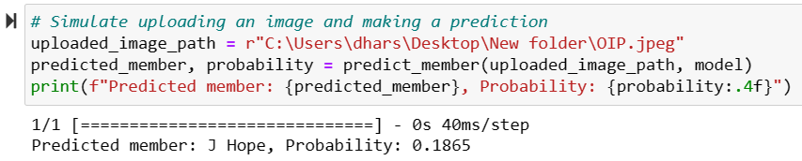
Results and Discussion
Class Prediction using CNN
The prediction process involves inputting an image of a member into a pre-trained neural network to identify which member of BTS it is.
The model receives an image, preprocesses it to match the input requirements (size and scale), and then feeds it into the neural network to predict the member's identity.
The output is a probability distribution across all possible classes (members), and the highest probability indicates the model's predicted member.
In this case, the image provided has been predicted by the model to be J Hope, with a probability of 18.65%. The prediction process combines image preprocessing, neural network processing, and probability analysis to identify the most likely member in the image.
The probability score is relatively low, indicating that the model is not highly confident in its prediction. This could be due to various factors such as the quality of the image, the similarity between the members, or the training data on which the model was trained.

Slide 18
Conclusion
Techniques for improved facial feature differentiation were explored, enhancing the system's ability to distinguish between individuals even under varied conditions such as different lighting or appearance changes​​.
A CNN model specifically tailored for the accurate recognition of BTS members was developed and refined through preprocessing and augmentation strategies.
Siamese Neural Network is yet to be implemented thereby boosting the model's performance and reliability on test datasets​​.
The model's accuracy and reliability to be thoroughly evaluated, ensuring its robustness and applicability in real-world scenarios​​.

Slide 19
Future Enhancement
Enhancing the dataset to cover a wider range of conditions and expressions for improved model robustness, while also refining the system for faster, real-time authentication.
Advancing cross-platform integration and developing stronger anti-spoofing measures to secure against fraudulent access attempts.
Incorporating privacy safeguards and continuous learning to ensure the system respects user privacy and adapts to new data over time.
Scaling the system for broader application and training on an internationally diverse set of faces to ensure global effectiveness.

Slide 20
References : APA format
Kumar, C. R., N, S., Priyadharshini, M., E, D. G., & M, K. R. (2023). Face recognition using CNN and Siamese network. Measurement: Sensors, 27(2023), 100800. https://doi.org/10.1016/j.measen.2023.100800
Solomon, E., Woubie, A., & Emiru, E. S. (2024). Deep Learning Based Face Recognition Method using Siamese Network. arXiv preprint arXiv:2312.14001. Retrieved from https://arxiv.org/abs/2312.14001
Hamdani, N. D., Bousahba, N., Bousbai, A. H., & Braikia, A. (2023). Face Detection and Recognition Using Siamese Neural Network. International Journal of Computing and Digital Systems, 14(1), 889-897. http://dx.doi.org/10.12785/ijcds/140169
Yu, H. Q. (2024). Attention Enhanced Siamese Neural Network for Face Validation. Artificial Intelligence and Applications, 2(1), 21–27. https://doi.org/10.47852/bonviewAIA32021018
Navghare, T., Muley, A., & Jadhav, V. (2024). Siamese Neural Networks for Kinship Prediction: A Deep Convolutional Neural Network Approach. Indian Journal of Science and Technology, 17(4), 352-358. https://doi.org/10.17485/IJST/v17i4.3018
Menendez, E., Martínez, S., Díaz-de-María, F., & Balaguer, C. (2024). Integrating Egocentric and Robotic Vision for Object Identification Using Siamese Networks and Superquadric Estimations in Partial Occlusion Scenarios. Biomimetics, 9(100), 1-21. https://doi.org/10.3390/biomimetics9020100
Hajamohideen, F., Shaffi, N., Mahmud, M., Subramanian, K., Al Sariri, A., Vimbi, V., ... & for the Alzheimer’s Disease Neuroimaging Initiative. (2023). Four-way classification of Alzheimer’s disease using deep Siamese convolutional neural network with triplet-loss function. Brain Informatics, 10(5). https://doi.org/10.1186/s40708-023-00184-w

